Slide 1

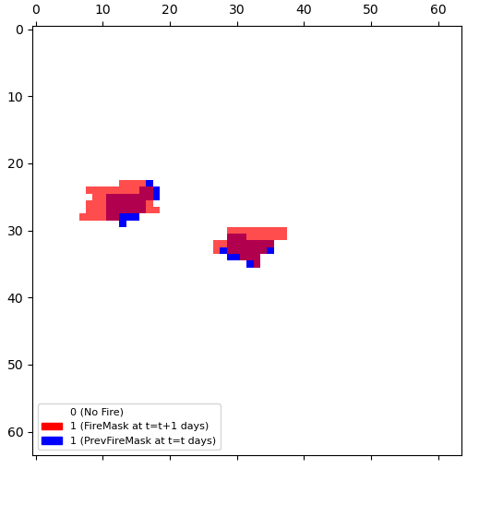
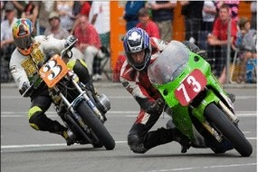
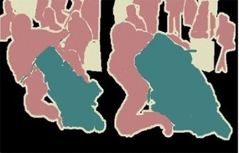
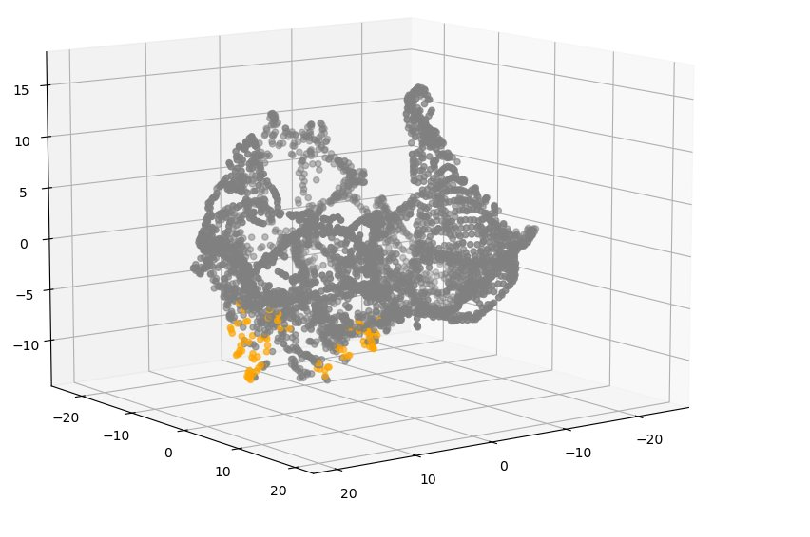
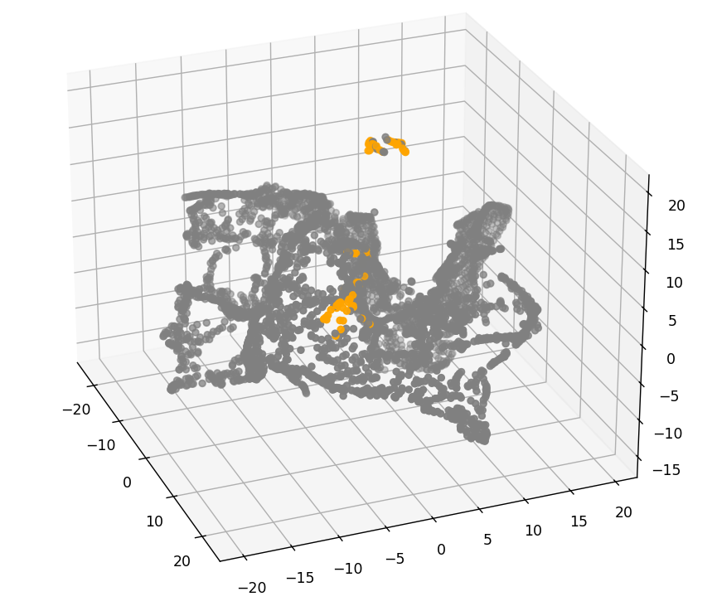
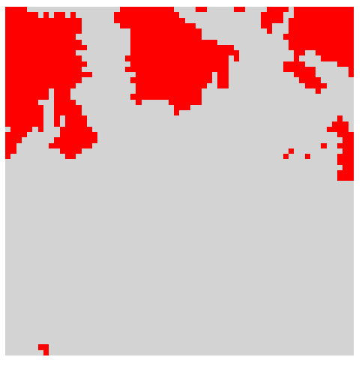
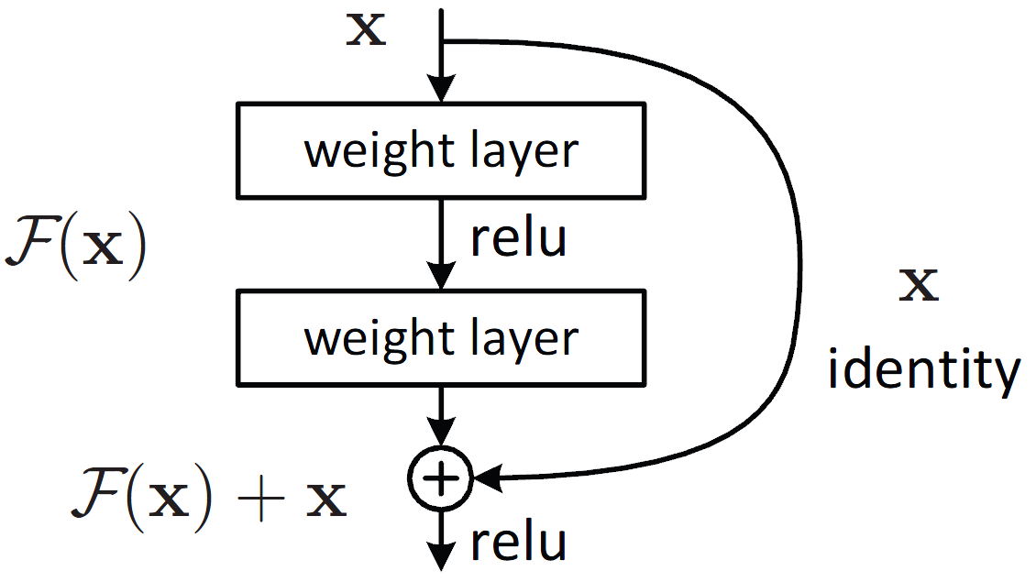




Exploration of Data Science and Machine Learning Techniques for Wildfire Prediction
Rachael Ballentine, Dr. Michael Raymer
College of Engineering and Computer Science
Wright State University, Dayton OH, USA
1. Background
3. Methodology
According to the National Interagency Fire Center, there were over 64,000 wildfires across the US in 2024 [1]
These fires affected over 8 million acres of land and caused a significant amount of damage to property and life [1]
Fire spread is a complex problem that depends on numerous variables including current fire location, weather conditions, and topography, and population
Machine learning models and algorithms can be used to predict probability of fire spread which is incredibly helpful for fire prevention and management
3. Convolutional Autoencoder
This project builds on the previous study,
. “Next Day Wildfire Spread: A Machine Learning Dataset to Predict Wildfire Spreading From Remote-Sensing Data”, by F. Huot, et. Al. [2].
A convolutional autoencoder for image segmentation was used for the above study and serves as the foundation for this project. The model developed in this project was trained on the Next Day Wildfire Spread (NDWS) dataset from [2] (available on Kaggle.com).
…12
Skip connections
Convolutional layer with Sigmoid activation
1. Previous Research
GOAL
Investigate and build upon an existing fire prediction model to improve performance
12-channel input image
Bottleneck latent space
1-channel output image
Semantic segmentation: classification of each pixel into a predefined class without differentiating between separate instances of a class
Encoder: Convolutional layers
Decoder: Deconvolutional layers
2. Data Visualization
x = 12
y = 1
Figure 3: Convolutional Autoencoder basic structure
Features:
Weather
Population
Maximum Temp
Minimum Temp
Wind Direction
Wind Velocity
Features: Precipitation
Precipitation
Humidity
PSDI
Features: Topography
Elevation
NVDI
Features: Other
ERC
Previous Fire Mask (at t = t days)
Data
NDWS Dataset made up of 18 files
Each file is 64x64km region at 1km resolution
Each dataset contained 12 features and 1 label
Data was from 2012-2020
t-SNE
ScikitLearn Standard Scalar used to scale data
Visualization considered both with and without Previous Fire Mask
Encoder
Convolutional layers with pooling to downsample and extract essential features from input image. Number of channels increases while spatial resolution decreases
Latent Space
Most spatially compressed representation of the image, with the most feature channels. Decoder draws on this information during reconstruction
Decoder
Deconvolutional layers to upsample and reconstruct an image based on the feature channels in the latent space. Number of channels decreases while spatial resolution increases. Compared to input image with loss function
Skip Connections
Helps decoder reconstruct finer details lost in latent space by providing feature maps from encoder layers with matching spatial resolution
Final Layer
FC Convolutional layer with sigmoid activation to flatten decoder output to a single segmentation map
Figure 1: Semantic image segmentation example [3]
Rather than 3 channel image like typical RBG image segmentation, we are considering each 64x64 file as an image with 12 channels
Treating the problem as image segmentation allows us to locate essential features from the 12-channel input image and classify them as either “fire” or “not-fire”
We input a 12-channel “image” and output a 1 channel segmentation map which tells us the predicted fire mask for the next day
Label:
FireMask at t = t + 1 day
2. Image Segmentation
Figure 3: Fire Mask (R) at t = t+1 days overlaid with Previous Fire Mask (B) at t = t days [2]
CAE
Figure 1: Data features and labels [2]
12-channel input
1-channel output = FireMask map
Figure 2: Transformation of 12-channel input to segmentation map output [2]
4. Future Work
TensorFlow Model
MobileNetV2 Encoder
Pix2Pix Decoder
Model from [2] was constructed in TensorFlow
TensorFlow model will be rebuilt in PyTorch using ResNet and semantic segmentation
Hyperparameters and number of layers will be tuned to improve model prediction results from those achieved in [2]
TensorFlow model uses 5 layers from MobileNetV2 architecture; number of layers could be increased with ResNet architecture
Next Gen Wildfire Model [2]
AUC | 28.4%
Precision | 33.6%
Recall | 43.1%
 | 0 - no fire
 | 1 - fire
Figure 2: Train-validation-test split
Figure 4: Eval 00 excluding Previous Fire Mask
Figure 5: Eval 00 considering Previous Fire Mask
5. References & Acknowledgements
REBUILD
Table 1: Model results from [2]
This project was funded by the Ohio Space Grant Consortium. I would like to thank my advisor, Dr. Michael Raymer, for his guidance and support, without which this project would not be possible. I would also like to thank Dr. Mitch Wolff for the opportunity to work with OSGC.
PyTorch Model
ResNet Encoder
ConvTranspose2D Decoder
References
[1] National Interagency Fire Center, “Wildland Fire Summary and Statistics Annual Report 2024,” 2024. [Online]. Available: https://www.nifc.gov/sites/default/files/NICC/2-Predictive%20Services/Intelligence/Annual%20Reports/2024/annual_report_2024.pdf
[2] F. Huot, R. L. Hu, N. Goyal, T. Sankar, M. Ihme and Y. -F. Chen, "Next Day Wildfire Spread: A Machine Learning Dataset to Predict Wildfire Spreading From Remote-Sensing Data," in IEEE Transactions on Geoscience and Remote Sensing, vol. 60, pp. 1-13, 2022, Art no. 4412513, doi: 10.1109/TGRS.2022.3192974
[3] Y. Guo, Y. Liu, T. Georgiou, and M. S. Lew, “A review of semantic segmentation using deep neural networks,” International Journal of Multimedia Information Retrieval, vol. 7, no. 2, pp. 87–93, Nov. 2017, doi: 10.1007/s13735-017-0141-z.
[4] K. He, X. Zhang, S. Ren and J. Sun, "Deep Residual Learning for Image Recognition," 2016 IEEE Conference on Computer Vision and Pattern Recognition (CVPR), Las Vegas, NV, USA, 2016, pp. 770-778, doi: 10.1109/CVPR.2016.90.
Figure 1: ResNet building block [4]
Tools used:

